Slide 1
Dual Circularly Polarized Antenna Measurement report
By Jethro Wang / Dave Zhang
2025/01/02

Slide 2
Content
Compliance Matrix
Antenna Photo
Measurement Setup
Return loss & Isolation
Gain & Axial ratio

Slide 3
Compliance Matrix
Item | Specification | Measurement #001 | Measurement #002 | Comply
Return loss | < -10 dB | < -11.17 dB | < -10.09 dB | Yes
Isolation | > 10 dB | > 10.29 dB | > 11.09 dB | Yes
Gain | > 15 dBi | > 17.28 dBi | > 17.31 dBi | Yes
Axial ration | 3 ~ 5 dB | < 4.51 dB | < 4.63 dB | Yes

Slide 4
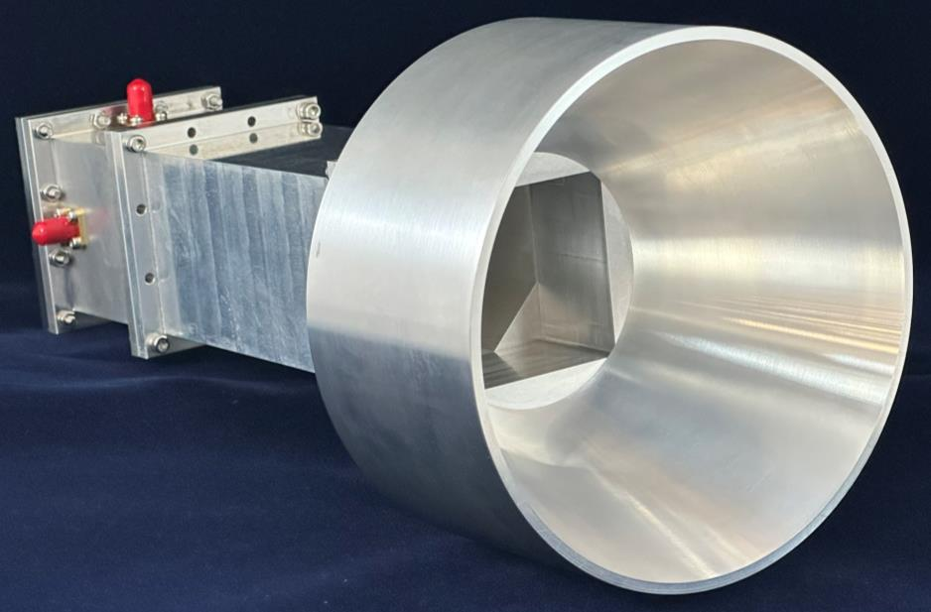
Antenna Photo
Port 2
Port 1

Slide 5
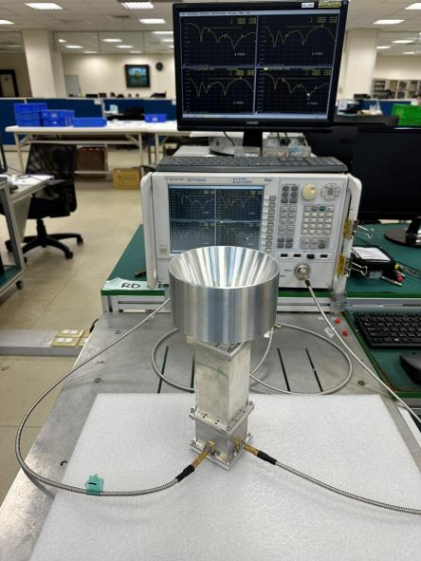
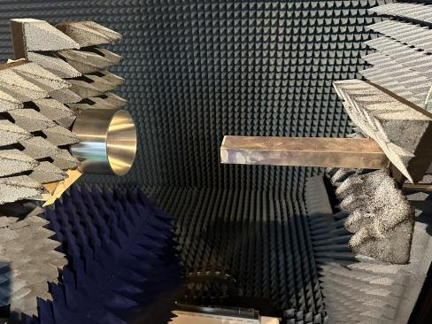
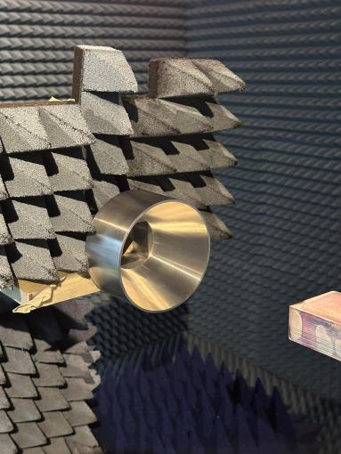
Measurement Setup
Return loss & Isolation
Gain & Axial ratio

Slide 6
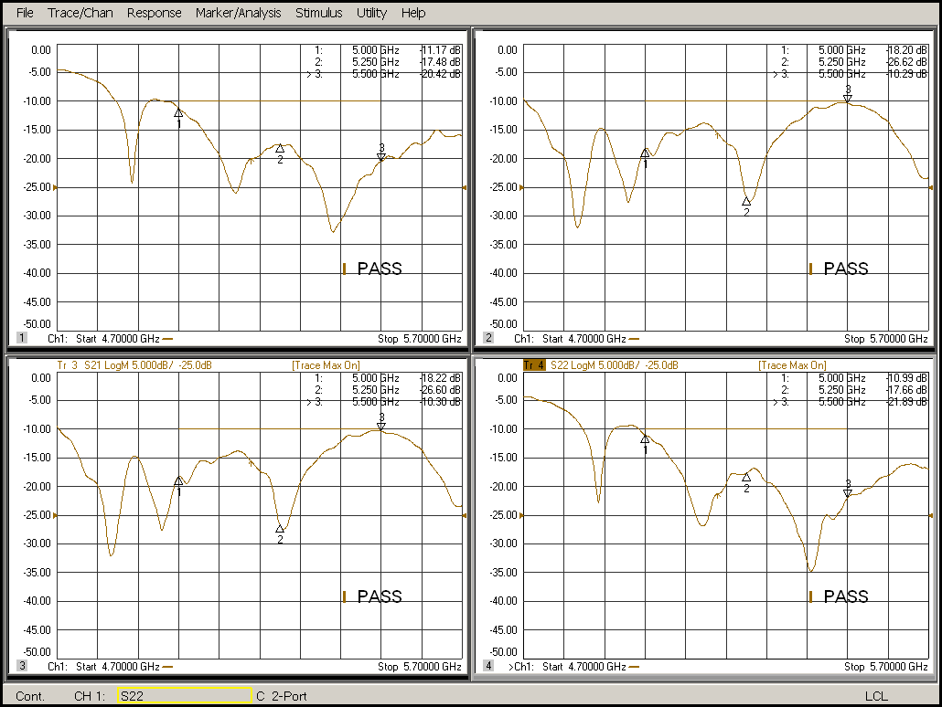
Return loss & Isolation – #001

Slide 7
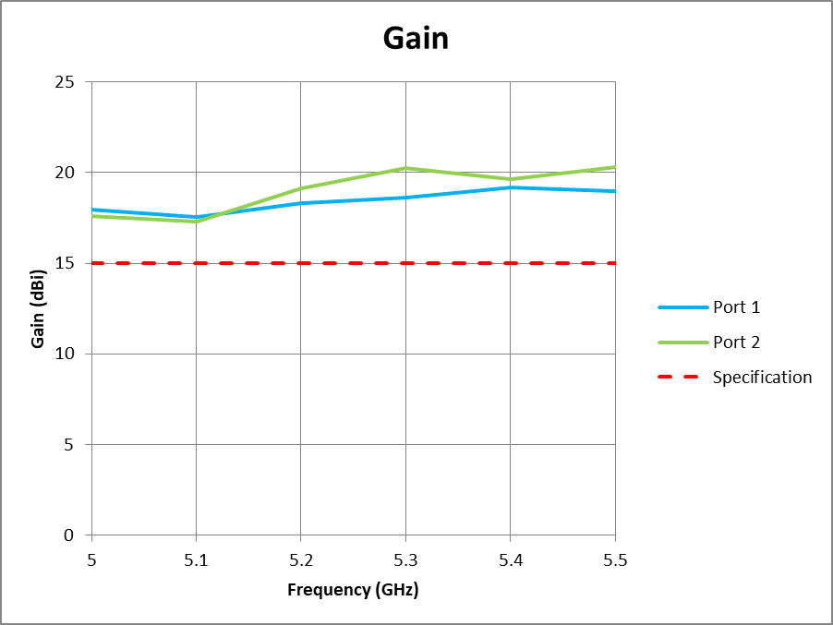
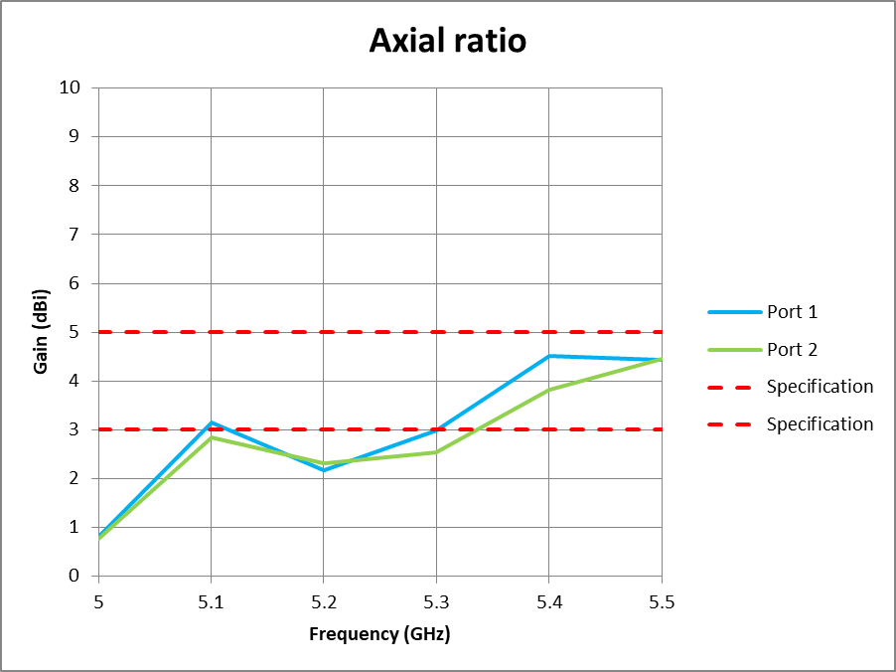
Gain & Axial ratio – #001

Slide 8
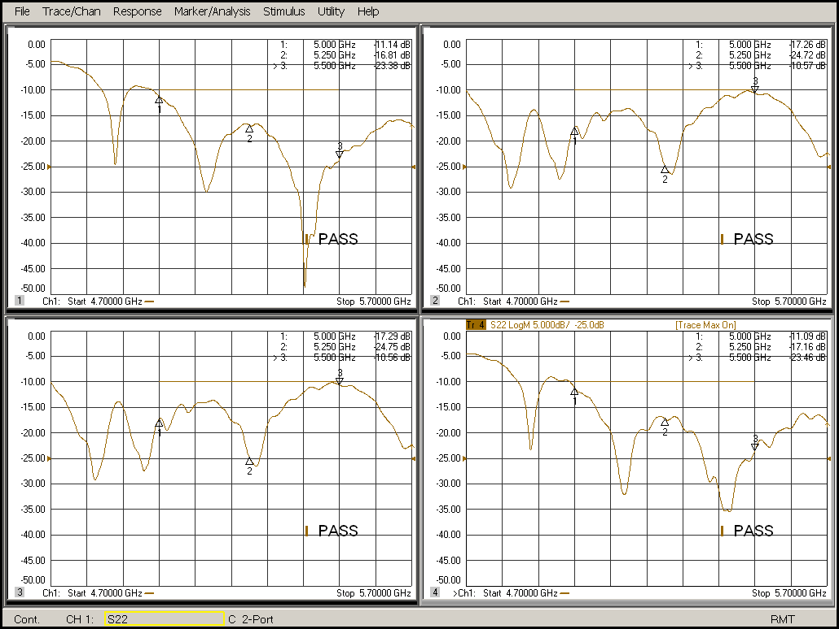
Return loss & Isolation – #002

Slide 9

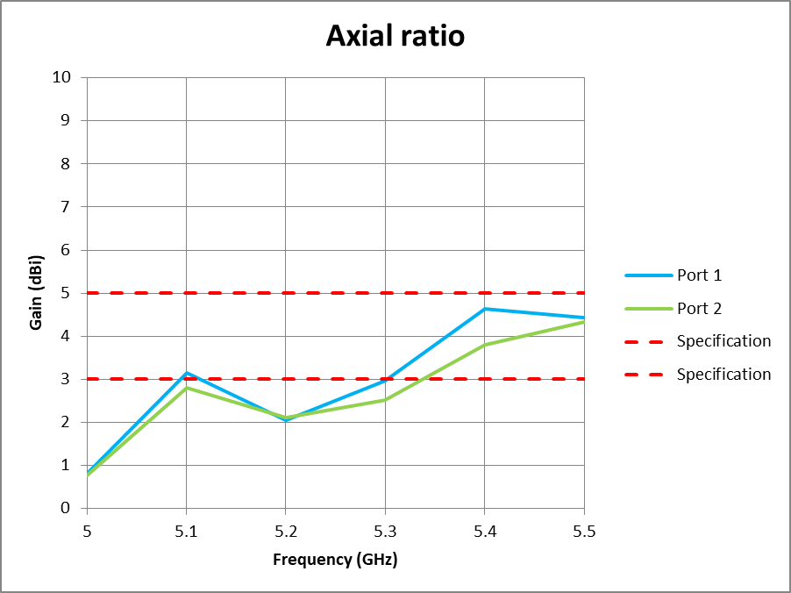
Gain & Axial ratio – #002

Slide 10
Gain & Axial ratio Table
Antenna #001
Item | 5.0 GHz | 5.1 GHz | 5.2 GHz | 5.3 GHz | 5.4 GHz | 5.5 GHz
Gain – Port 1 | 17.94 | 17.55 | 18.33 | 18.60 | 19.20 | 18.97
Gain – Port 2 | 17.61 | 17.28 | 19.14 | 20.23 | 19.64 | 20.28
Axial ratio – Port 1 | 0.81 | 3.14 | 2.17 | 2.99 | 4.51 | 4.43
Axial ratio – Port 2 | 0.76 | 2.85 | 2.31 | 2.55 | 3.83 | 4.45
Antenna #002
Item | 5.0 GHz | 5.1 GHz | 5.2 GHz | 5.3 GHz | 5.4 GHz | 5.5 GHz
Gain – Port 1 | 17.96 | 17.59 | 18.29 | 18.64 | 19.31 | 19.09
Gain – Port 2 | 17.63 | 17.31 | 19.17 | 20.26 | 19.69 | 20.40
Axial ratio – Port 1 | 0.82 | 3.15 | 2.06 | 2.98 | 4.63 | 4.43
Axial ratio – Port 2 | 0.77 | 2.80 | 2.12 | 2.52 | 3.80 | 4.34

Slide 11
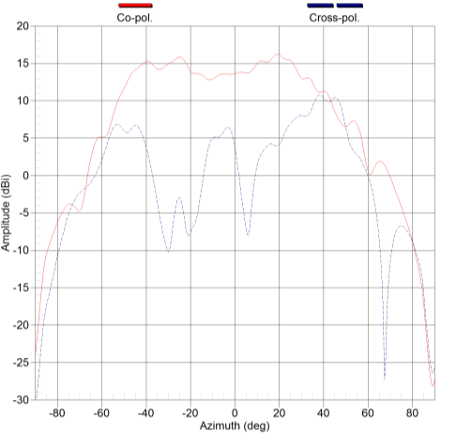
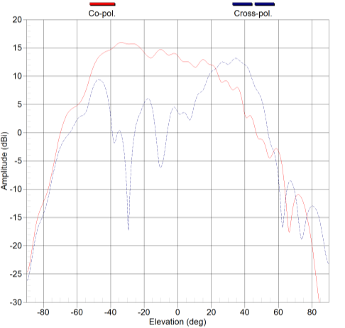
Radiation pattern @ 5 GHz #001 – Port 1
Azimuth
Elevation

Slide 12
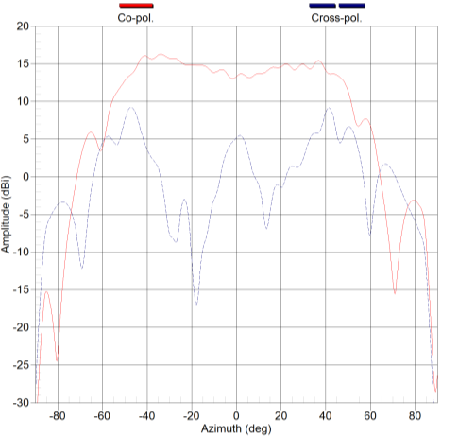
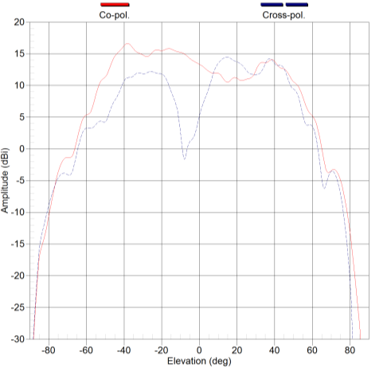
Radiation pattern @ 5.3 GHz #001 – Port 1
Azimuth
Elevation

Slide 13
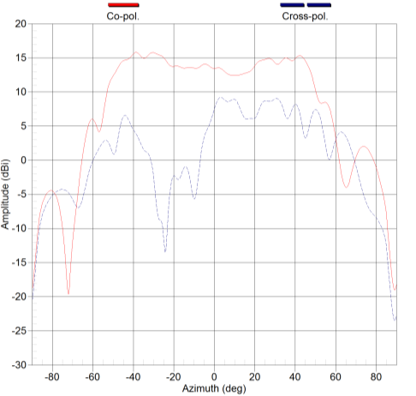
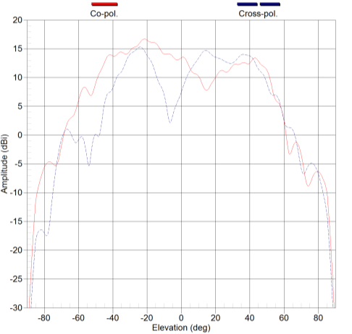
Radiation pattern @ 5.5 GHz #001 – Port 1
Azimuth
Elevation

Slide 14
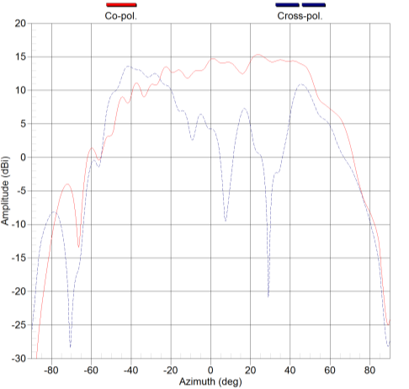
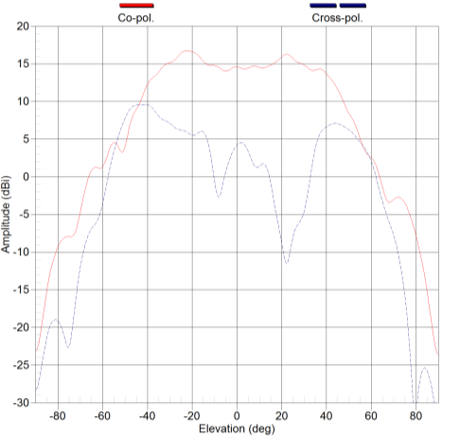
Radiation pattern @ 5 GHz #001 – Port 2
Azimuth
Elevation

Slide 15
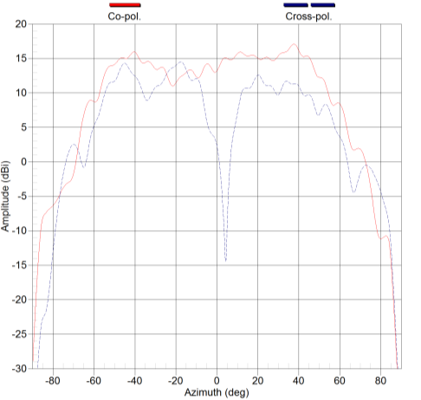
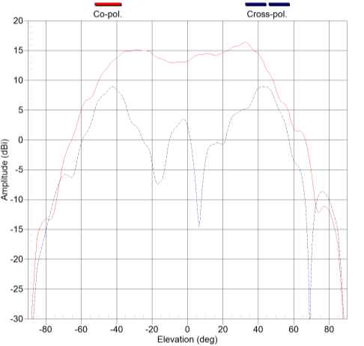
Radiation pattern @ 5.3 GHz #001 – Port 2
Azimuth
Elevation

Slide 16

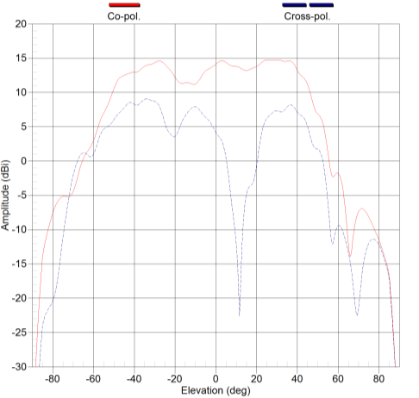
Radiation pattern @ 5.5 GHz #001 – Port 2
Azimuth
Elevation

Slide 17
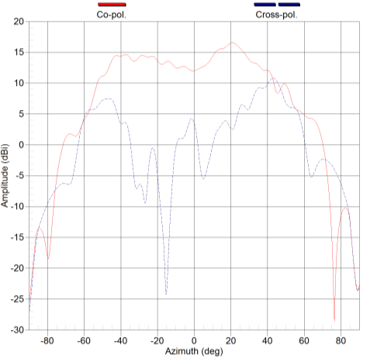
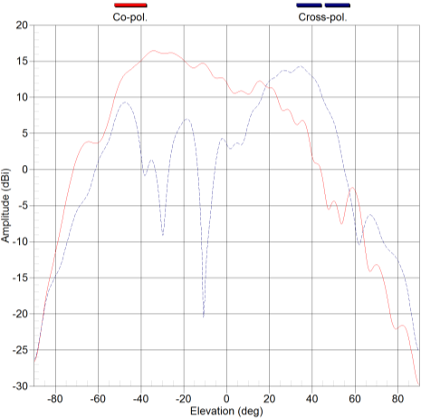
Radiation pattern @ 5 GHz #002 – Port 1
Azimuth
Elevation

Slide 18
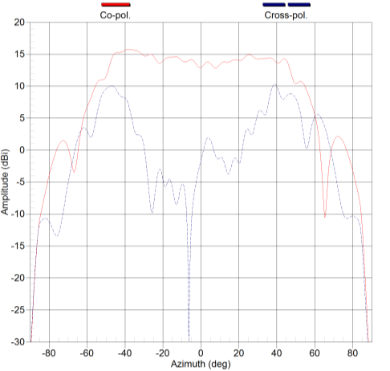
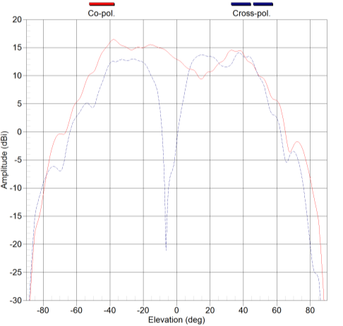
Radiation pattern @ 5.3 GHz #002 – Port 1
Azimuth
Elevation

Slide 19
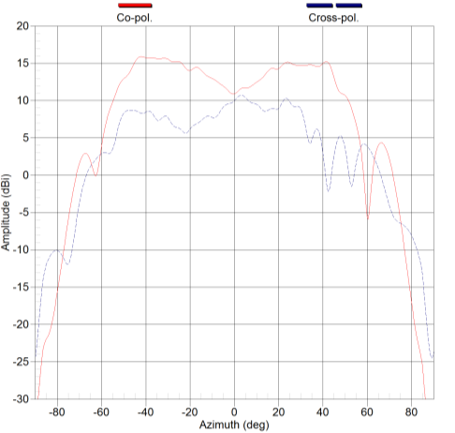
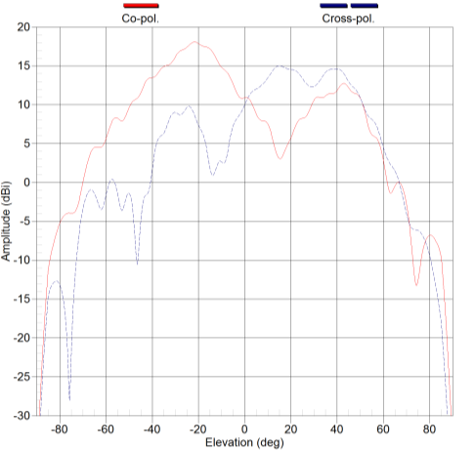
Radiation pattern @ 5.5 GHz #002 – Port 1
Azimuth
Elevation

Slide 20


Radiation pattern @ 5 GHz #002 – Port 2
Azimuth
Elevation

Slide 21
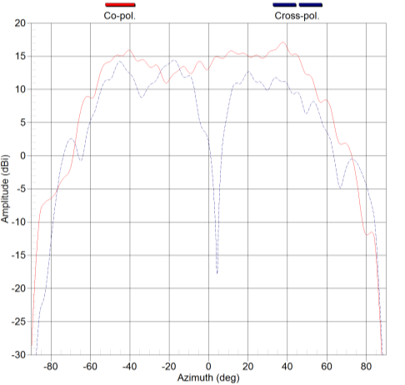

Radiation pattern @ 5.3 GHz #002 – Port 2
Azimuth
Elevation

Slide 22


Radiation pattern @ 5.5 GHz #002 – Port 2
Azimuth
Elevation

Slide 23


